Slide 1
ANN

Slide 2
Learning
Supervised Learning - Providing the network with a series of sample inputs and comparing the output with the expected responses.
Unsupervised Learning - Most similar input vector is assigned to the same output unit.
Reinforcement Learning - Right answer is not provided but indication of whether ‘right’ or ‘wrong’ is provided.

Slide 3
LAYER PROPERTIES
Input Layer: Each input unit may be designated by an attribute value possessed by the instance.
Hidden Layer: Not directly observable, provides nonlinearities for the network.
Output Layer: Encodes possible values.

Slide 4
MULTI LAYER ARTIFICIAL NEURAL NET
INPUT: records without class attribute with normalized attributes values.
INPUT VECTOR: X = { x₁, x₂, …, x_{n}} where n is the number of (non-class) attributes.
INPUT LAYER: there are as many nodes as non-class attributes, i.e. as the length of the input vector.
HIDDEN LAYER: the number of nodes in the hidden layer and the number of hidden layers depends on implementation.

Slide 5
WEIGHT AND BIAS UPDATION
Per Sample Updating
updating weights and biases after the presentation of each sample.
Per Training Set Updating (Epoch or Iteration)
weight and bias increments could be accumulated in variables and the weights and biases updated after all the samples of the training set have been presented.

Slide 6
STOPPING CONDITION
All change in weights (Δwij) in the previous epoch are below some threshold, or
The percentage of samples misclassified in the previous epoch is below some threshold, or
A pre-specified number of epochs has expired.
In practice, several hundreds of thousands of epochs may be required before the weights will converge.

Slide 7
NEURAL NETWORKS
Neural Network learns by adjusting the weights so as to be able to correctly classify the training data and hence, after testing phase, to classify unknown data.
Neural Network needs long time for training.
Neural Network has a high tolerance to noisy and incomplete data.

Slide 8
General Procedure for Building Neural Networks
Formulating neural network solutions for particular problems is a multi-stage process:
Understand and specify your problem in terms of inputs and required outputs, e.g. for classification the outputs are the classes usually represented as binary vectors.
Take the simplest form of network you think might be able to solve your problem, e.g. a simple Perceptron.
Try to find appropriate connection weights (including neuron thresholds) so that the network produces the right outputs for each input in its training data.
Make sure that the network works on its training data, and test its generalization by checking its performance on new testing data.
If the network doesn’t perform well enough, go back to stage 3 and try harder.
If the network still doesn’t perform well enough, go back to stage 2 and try harder.
If the network still doesn’t perform well enough, go back to stage 1 and try harder.
Problem solved – move on to next problem.

Slide 9
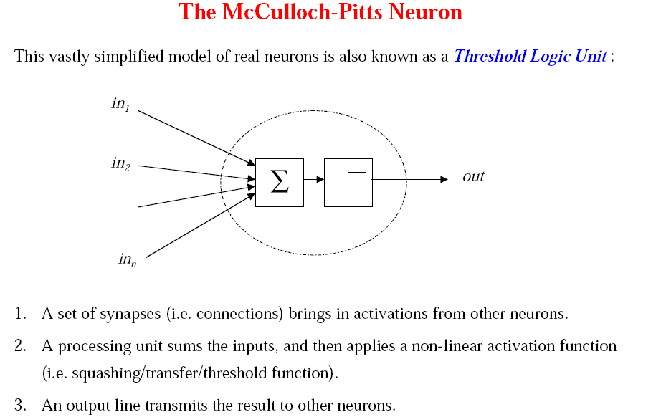

Slide 10


Slide 11
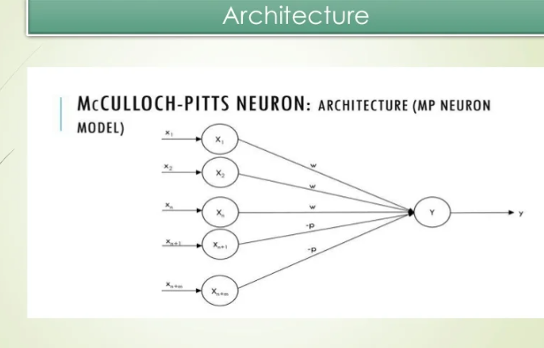

W is excitatory weights and p is inhibitory weight

Slide 12
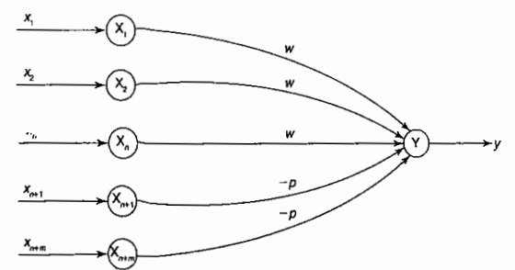

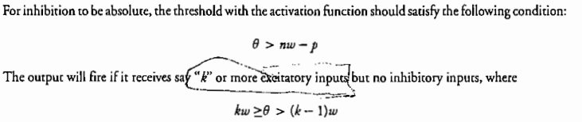
M-P Neuron (Architecture)
Activation Function

Slide 13
M-P Neuron

Slide 14
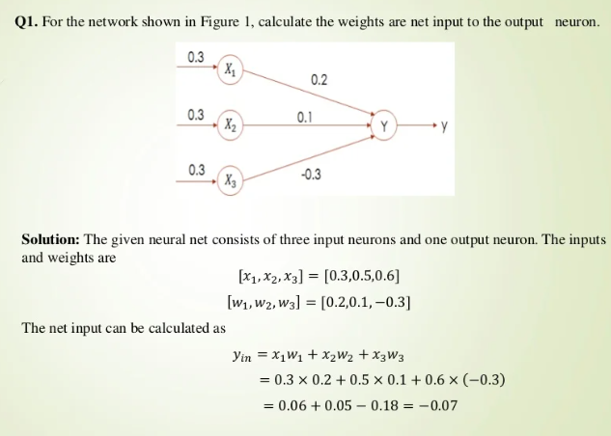
Example

Slide 15
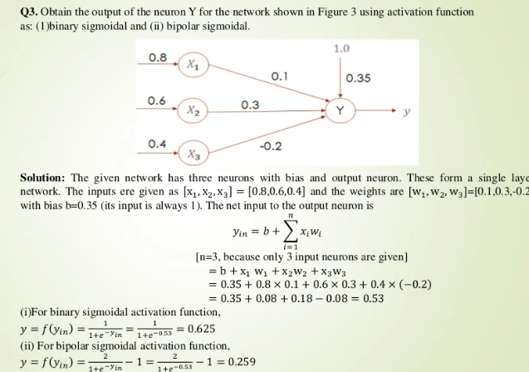
Example

Slide 16
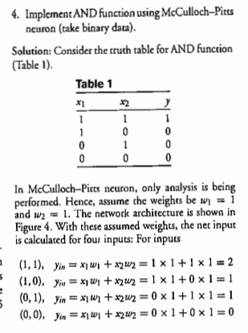
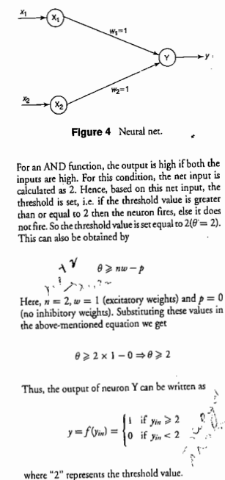

Slide 17
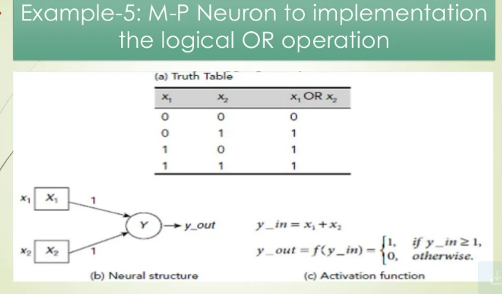

Slide 18
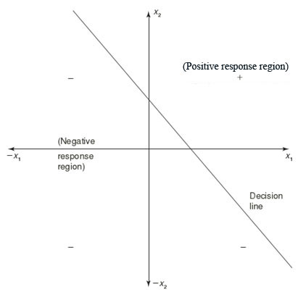
LINEAR SEPARABILITY
An ANN does not give exact solution for a non linear problem. It provides possible approximate solution
Linear separability is the concept wherein the separation of the input space into regions is based on whether the network response is positive or negative.
The concept of separability applies to binary classification problems. In them, we have two classes: one positive and the other negative. We say they’re separable if there’s a classifier whose decision boundary separates the positive objects from the negative ones.
Consider a network having positive response in the first quadrant and negative response in all other quadrants (AND function) with either binary or bipolar data, then the decision line is drawn separating the positive response region from the negative response region.

Slide 19


Linear Separability
Linear separability, is the concept wherein the separation of the input space into regions is based on whether network response is positive or negative . Generally the net input is calculated to the output unit is given as
If there exist weights (with bias) for which the training input vectors having positive (correct:) response,+ ve lie on one side of the decision boundary and all the other vectors having negative (incorrect) response, -1, lie on the other side of the decision boundary then it can be concluded that the problem is "linearly separable." This region may be called as decision boundary and can be determined by the relation

Slide 20
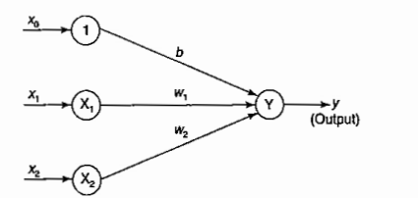



Example

Slide 21

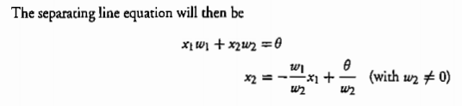
Exam
If threshold is used then

Slide 22
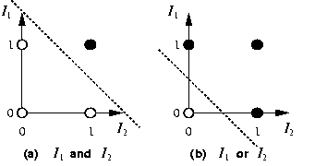
AND and OR linear Separators

Slide 23
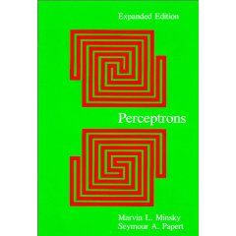
Linear Separability
x₂
Not linearly separable
+
−
XOR
x₁
−
+
Minsky & Papert (1969)
Bad News: Perceptrons can only represent linearly separable functions.

Slide 24
Linear Separability: XOR
Consider a threshold perceptron for the logical XOR function (two inputs):
Our examples are:
x1 x2 label
1 0 0 0
2 1 0 1
3 0 1 1
4 1 1 0
Given our examples, we have the following inequalities
for the perceptron:
From (1) 0 + 0 ≤ T → T≥0
From (2) w₁+ 0 > T → w₁ > T
From (3) 0 + w2 > T → w₂ > T
From (4) w1 + w2 ≤ T
w1 + w2 > 2T
contradiction
So, XOR is not linearly separable

Slide 25
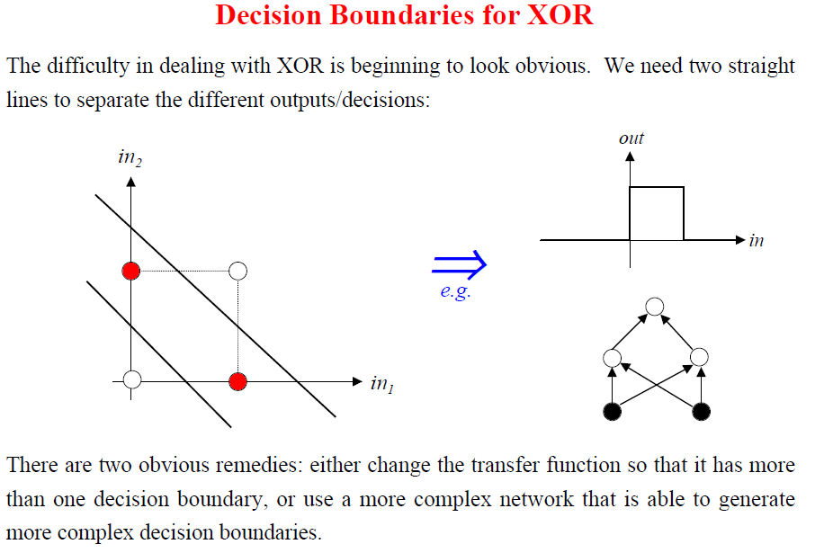

Slide 26
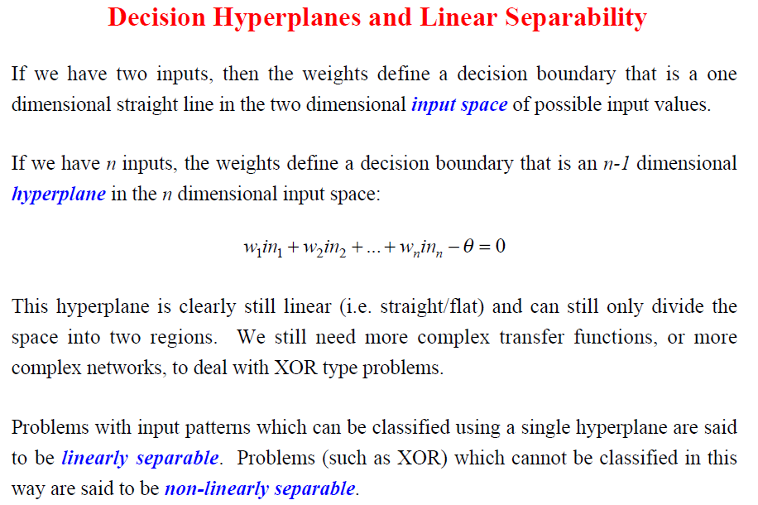

Slide 27
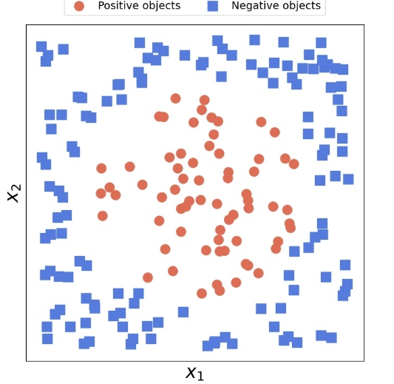
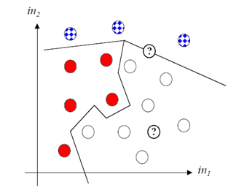
Example of Non linear Boundary

Slide 28

Hebb Network
According to the Hebb rule, the weight vector is found to increase proportionately to the product of the input and the learning signal. Here the learning signal is equal to the neuron's output. In Hebb learning, if two interconnected neurons are 'on' simultaneously then the weights associated with these neurons can be increased by the modification made in their synaptic gap (strength). The weight update in Hebb rule is given by
The Hebb rule is more suited for bipolar data than binary data

Slide 29

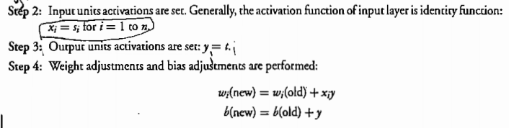
Training Algorithm

Slide 30
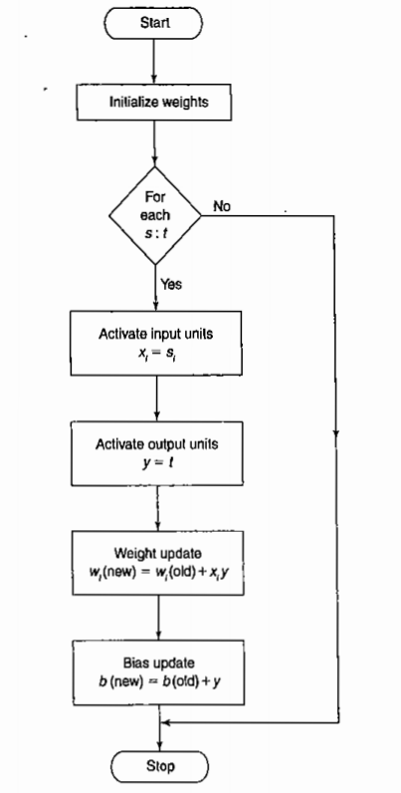

Slide 31
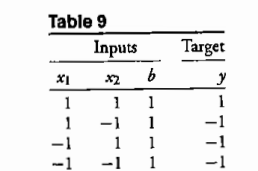
Example
Design a Hebb net to implement logical AND function (use bipolar inputs and targets).
Initially set w1=w2=0
b=0

Slide 32
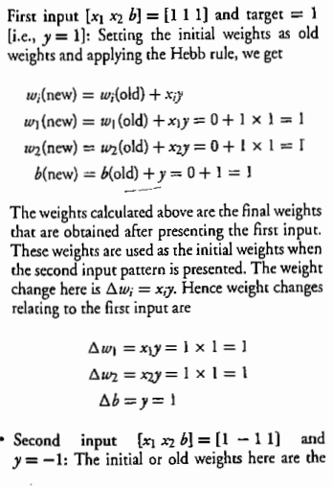
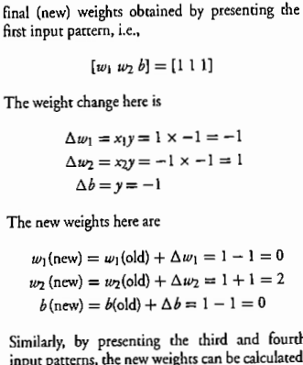

Slide 33
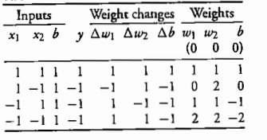
Table

Slide 34
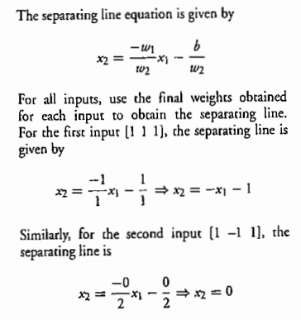

Slide 35
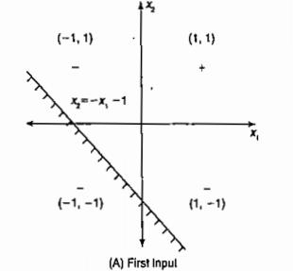
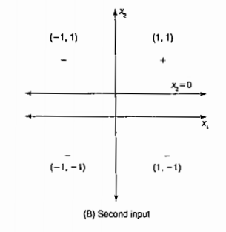
Not separating +ve samples frpm -ve

Slide 36
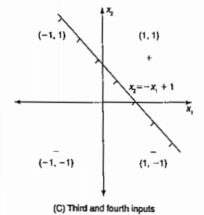
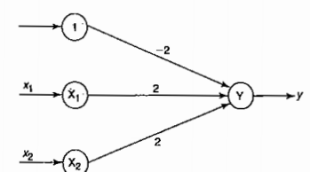
The boundary line is same for the both third and fourth training pairs. And, the decision boundary line obtained from these input training pairs separates the positive response region from he negative response region. Hence obtained from this are the final weigh given as w1=2, w2=2, b=-2
Hebb Net for AND operation

Slide 37
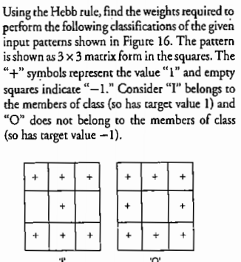
Exercise

Slide 38
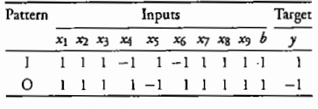
Hint

Slide 39
References
Book on “Principles of Soft Computing” by Dr. S. N Sivnamdam and Dr. S. N. Deepa

